Slide 1
Using ClassDojo

Slide 2
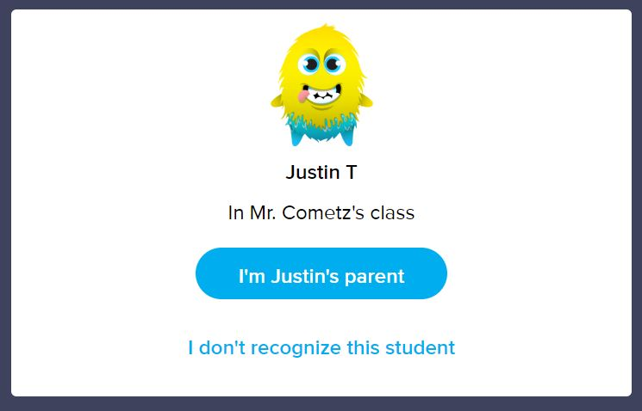
Creating an account
Using a parent code
Go to home.classdojo.com
Select “parent” from the centre of the screen.
Enter your parent code and select “check code” and click on “I’m ____’s parent.”

Slide 3
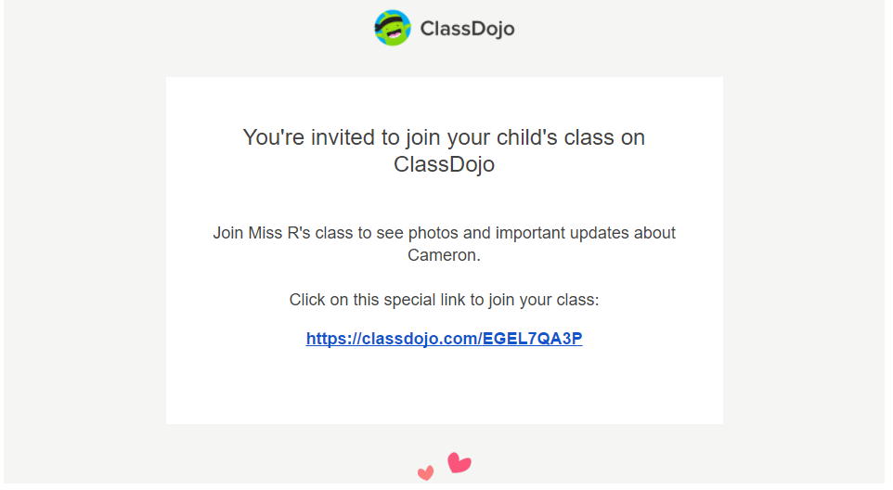
To create an account using an email invite:
Click on the link in your email invite.
Click on the “I’m ___’s parent” button.
Enter your first and last name, email address and create a password before clicking “sign up.”
Please Note: If you already have an account, click on the “log in now” button instead of creating new login information

Slide 4
Compatible Devices
ClassDojo can be used and accessed across a number of different devices. ClassDojo operates on the following devices and platforms:
iOs devices: iPhones, iPads
Android phones and tablets
Kindle Fire
On any computer, supported by Google Chrome and Firefox
Please note that ClassDojo is not supported by Internet Explorer 10 anymore. It is recommended to use Google Chrome.

Slide 5
ClassDojo App
The ClassDojo app is available through the App Store and Google Play store and is 100% free to use.
As a parent, the app will allow you to do the following:
Safely and privately message with your child’s teacher.
View, like and comment on the pictures/posts that your child’s teachers posts to the class story.
View files and posts posted by the classroom teacher onto the story.
Post photos of your child doing their work or of their completed work (please be aware these photos are just visible by yourself and the teacher, no other students can view these).
The app will look like this!

Slide 6
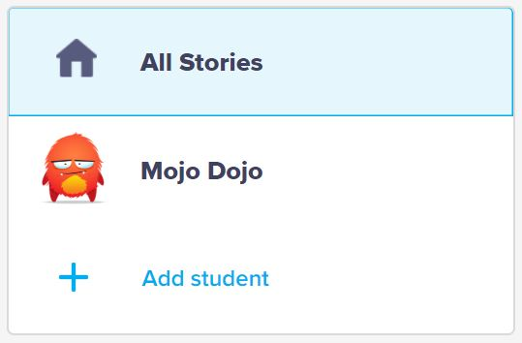
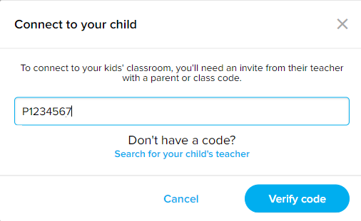
Adding multiple students/classes to one account
You will need a parent code from each class to add more than one student to the one account. To add another parent code:
Click on the “+Add student” button on the left side of your screen
Enter your parent code (this code is 7-9 digits and starts with a P), and click on verify code. Each students will have a unique parent code.
You can now toggle between your students to view their accounts by selecting the student from the left hand side of the screen.

Slide 7
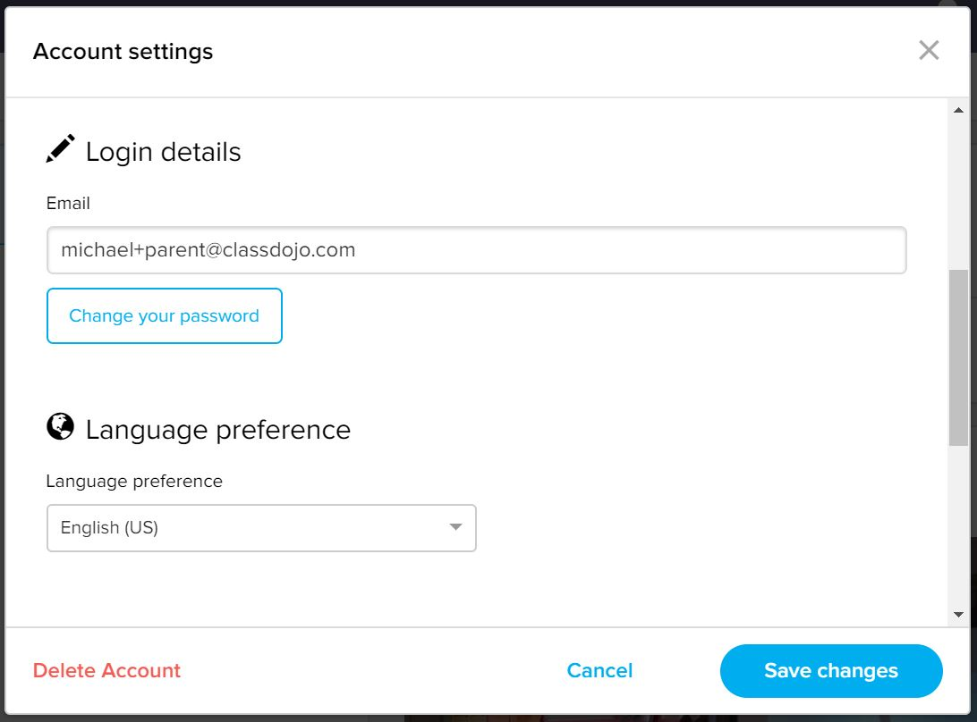
Changing the email address for your account
From the web:
Click on your icon in the upper right corner of the screen.
Click on “account settings”.
Under “Login details,” edit your email address.
Scroll down to the bottom of the pop-up box and click “save changes” before exiting.

Slide 8
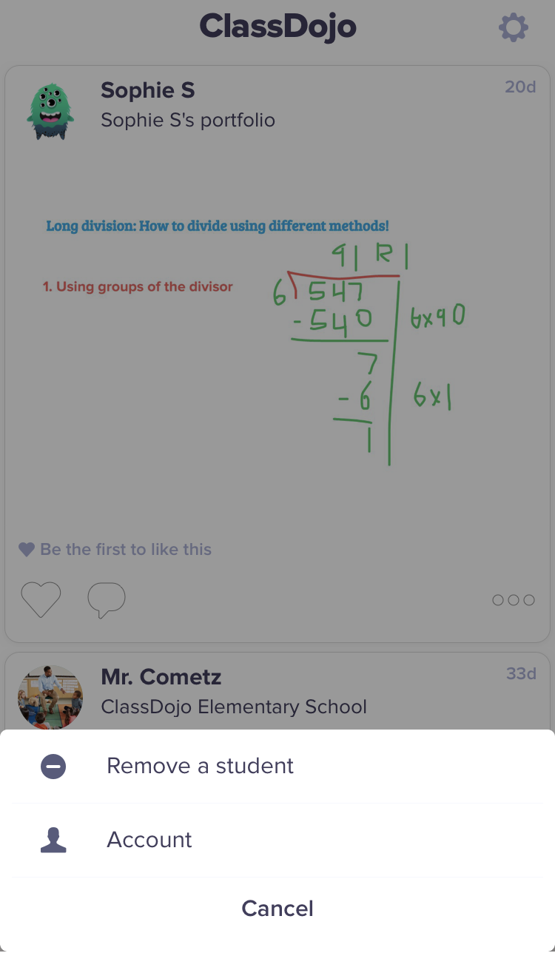
From your iPhone/iPad:
Log into your account with your email address and selected password.
Tap on the gear button icon in the upper right corner of the screen and select “account”.
Tap on “edit”.
Tap on your email address, delete the existing address and type your new email address.
Tap on “save.
Tap the back arrow in the upper left corner of the screen to go back to your account.

Slide 9
Reset a lost or forgotten password
If you have lost or forgotten your password, you can reset your password by following these instructions:
Go to https://home.classdojo.com/forgot
Enter your login email address.
Check your email for a link to reset your password. If you do not get it right away, check your junk folder.

Slide 10
How to translate messages and posts
To translate message and posts from your child's teacher, you must have your language settings set to your desired language. To se your preferred account language on the web:
Click on your name in the upper right corner.
Select “account settings”.
Under “Language preference,” select your preferred language.
Click the blue “save changes” button.

Slide 11
To change your language settings on an iphone/tablet:
Tap the gear icon in the upper right corner
Select “account”
Select “Language,” to view the list of languages
Select your preferred language and your account will automatically update to it

Slide 12
Uploading work/photos to your child’s profile
Uploading photos of your child and their work is a great way to show your teacher what you are doing! When uploading photos, this feature can only be accessed via phone or tablet for now, not via the desktop. To do this, follow these steps:
Sign into the app as a parent via mobile or tablet.
Click on the profile image with arrow from a drop down menu in the top left of the app.
You will see the child’s name, press on it.
Press on the class name (this is the child’s portfolio).
There may be ‘to do’ work set by the teacher.
To upload work, click on the plus sign next to the word ‘completed’ – you will have the option to add a journal, video, photo or drawing.
Once work is completed, you press the ‘send arrow’ at the top right corner. Photos will only be visible by yourself and the teacher, no other students can view these.

